Slide 1
Process Hacker
By: Dylan Fox, My nigga banku(Jo)((This Boy has waves))(((And some ugly ass facial hair)))((((And a big dick))))(((((And a big heart;) ))))), and Kyle Muñoz

Slide 2
Main Uses
Processes
Services
Network
Disk

Slide 3
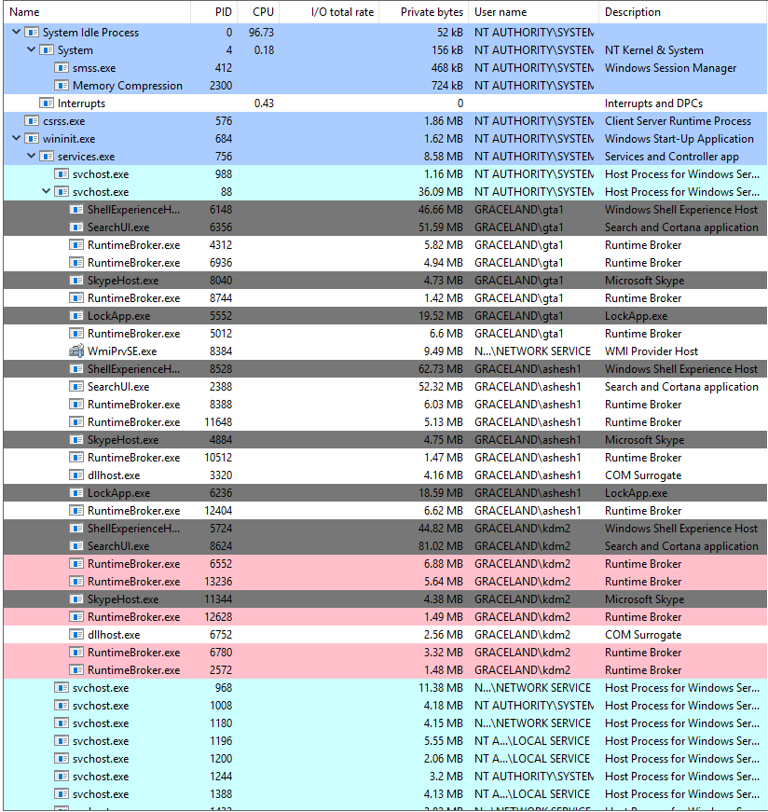
Processes
Highlights
Properties
I/O Priority
Terminate, Suspend, or Restart Processes

Slide 4
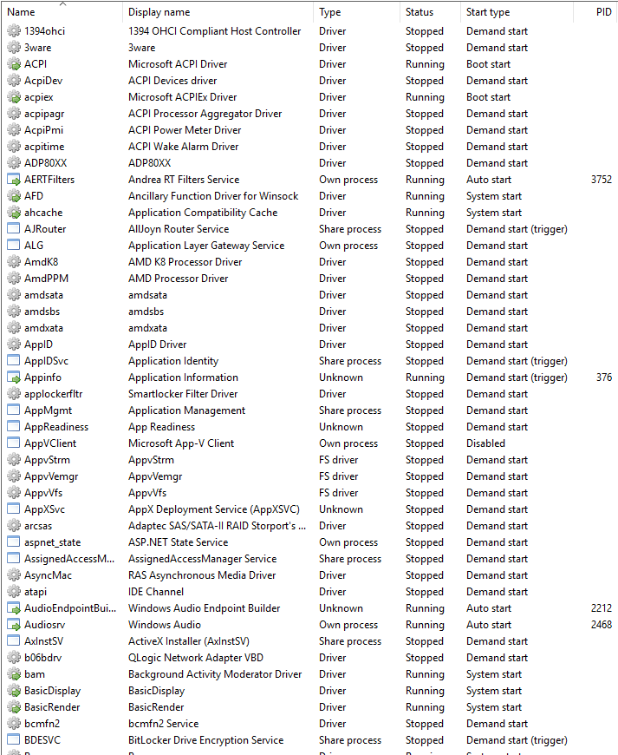
Services
Five Columns
Properties
General
Security
Recovery

Slide 5
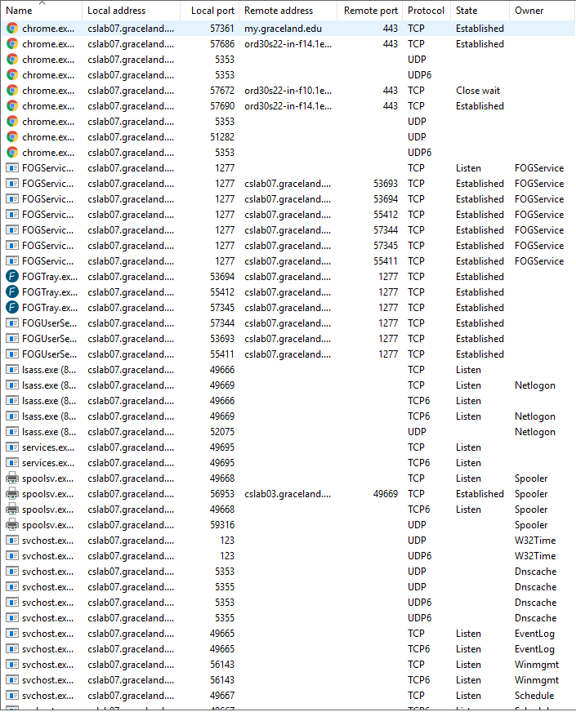
Network
Local/Remote Address
General Information
Ping/Traceroute a Process
Pinpoint Network Problems

Slide 6
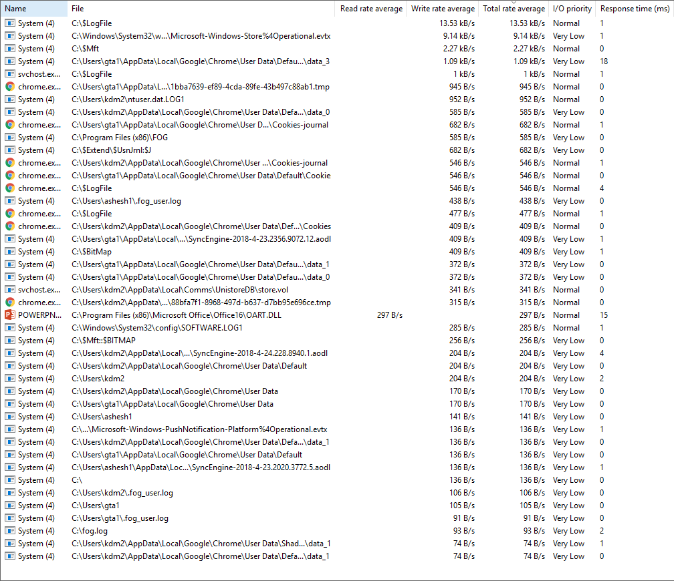
Disk
Requires Admin Privileges
Time Usage
Rate Averages
I/O Priority
Response Times

